Slide 1
Software Reuse
TOPIC 1
UTM-SERG Research & Consultancy Team
School of Computing
Faculty of Engineering
Universiti Teknologi Malaysia
UTM, Skudai, Johor.

Slide 2
AGENDA
Agenda 1: Introduction
Agenda 2: Reuse techniques
  Objects
  Patterns
  Frameworks
  Components
  Domain and product line engineering
  Meta-programming and generator
  Model-driven architecture
  Aspects
  Technique synergy and integration
Agenda 3: Technologies and Approaches
Agenda 4: Cost Benefit Model
Agenda 5: Summary

Slide 3
Introduction
Today, complex, high quality computer- based-systems must be built in a very short time periods. This results in a organized approach to reuse.
Component-Based-Software-Engineering (CBSE) is a process that emphasizes the design and construction of computer- based systems using reusable components.

Slide 4
Introduction
Software component reuse, does not just mean the reuse of code. It also includes the reuse of specifications and designs.
Types of Software reuse:
  Code components: functions, modules, subsystems etc.
  Abstract Products: specifications, designs etc.
The potential gains from reusing specifications may be greater than reusing code component. Code contains low-level detail which may specialize it to such extent that it cannot be reused. Designs or specifications are more abstract and hence more widely applicable.

Slide 5
Introduction
Different levels of Reuse
  The reuse of software can be considered at a no. of different levels:
    i. Application system reuse: The whole of an application system may be reused. For this the software must be portable i.e. it should execute on different platforms.
    ii. Sub-system reuse: Major sub-systems of an application may be reuse.
    iii. Module or object reuse: Components of a system representing a collection of functions may be reuse. For eg., a C++ object implementing a binary tree may be reused in different applications.
    iv. Function reuse: Software components which implement a single function, such as mathematical functions, may be reused.

Slide 6
Introduction
Advantages of Reuse
  A systematic reuse in the development process leads to the following advantages:
    i. System reliability is increased: These components have been tested in operational systems and have therefore been exposed to realistic operating conditions.
    ii. Overall process risk is reduced: Less uncertainty in the costs of reusing that component than in the costs of development. It reduces uncertainties in project cost estimation.
    iii. Effective use can be made of specialists: Instead of application specialists doing the same work on different projects, these specialists can develop reusable components which encapsulate their knowledge.
    iv. Standard Compliance: Organizational standards can be embodied in reusable components. Eg. user interfaces.
    v. Software development time can be reduced: Reusing components speeds up system production because both development and validation time should be reduced.

Slide 7
Reuse components
A software asset:
  Any artifact resulting from one stage in a development task
  Any mapping from the artifact produced by one development stage to the artifact produced by the next
Assets can be at any level of abstraction and software process stage:
  Domain/business analysis/model
  Application requirements
  Application architectures and generic architecture patterns
  Application design/model and generic design patterns
  Source code
    Libraries, modules, packages
    Classes, templates, idioms
    Objects, functions, subroutines, data
  Executable code: executable components, bytecode, binary code
  Documentation and meta-data
  Test suites and test generators
Any information, formalism or tool used during development can also be subject to reuse
  Languages, CASE tools, IDE, processes

Slide 8
Reuse Techniques
Subroutines and functions:
  Source code level reuse
  Specific to given platform
  Finest grain
  Within given application
Modules, libraries and packages:
  Source code level reuse
  Specific to given platform
  Larger grained
  Across applications

Slide 9
Object-orientation: reuse strengths
Pervades all life-cycle, abstraction and executability levels
Associated with detailed engineering processes and methods
Classes bundle a structural and a behavioral template that is reused each time an object of the class is created
OO platforms usually come with vast libraries of built-in classes
Inheritance provides structural and behavioral model and code reuse through specialization
Abstract class and interfaces provide structural and service specification reuse through variable realization/implementation

Slide 10
Object-orientation: reuse strengths
Private attributes accessible only through public access methods provide encapsulation, making classes and objects reusable units
Overloading, polymorphism and dynamic binding provide client reuse across diverse realizations of servers sharing a common specification
Entity-centered modeling at gradual abstraction levels and associated standard visual notation (UML) greatly facilitates OO model and code comprehension for white-box reuse

Slide 11
Object-orientation: reuse weaknesses
Public attributes break encapsulation along associations, hindering model and code element locality and thus ease of reuse
Protected attributes and methods break encapsulation down the class hierarchy,
Attribute value and method realization overriding down the class hierarchy breaks interface semantics inheritance and thus encapsulation
Classes too fine grained reuse units
Packages more adequate and more variable grained reuse units but lack most reuse-fostering features of classes

Slide 12
Patterns
Modeling patterns:
  Artifact view: abstract analysis/design template which instances recur across domains and applications
  Mapping view: pair associating a set of requirements (generic design problem) to a analysis/design template known to satisfy it (generic design solution)
  Capture know how of experienced analysts
  Two granularity levels: architectural, design
  Two complementary aspects: structural/static and behavioral/dynamic

Slide 13
Patterns
Architectural patterns:
  Template for decomposition of system into modules/components with names and roles together with their data flows, structural and behavioral relationships
  Coarse-grained modeling patterns
  Specified in special-purpose architectural languages or in UML
Design patterns (generally object-oriented):
  Template for associated classes that together provide a given generic service
  Finer grained modeling patterns
Programming patterns (idioms, styles):
  Conventional, restricted use of programming language constructs to realize design pattern

Slide 14
Object-oriented frameworks
In contrast to patterns, frameworks are specific to a given domain, but independents of any particular application requirements
Two main elements:
  Set of interrelated interfaces and abstract classes that represent a predefined software architecture skeleton
  Set of interrelated concrete classes that provide as built-in the conceptual entities of the domain and the common services shared by most applications in the domain
Building an application with a framework consists of:
  Reusing the concrete classes by calling their methods
  Reusing the concrete classes by specializing them, with or without overriding
  Reusing the abstract classes and interfaces by realizing them
  All three guided by the application’s requirements
Reuse occurs massively at the domain engineering and design stages (almost entirely avoided) and partially at the implementation stage
Sometimes comes associated with:
  A domain-specific development process/method
  A domain-specific CASE tool and/or IDE

Slide 15
Components
What is a component?
No standard, universally accepted definition
In essence, any software unit that:
  Is “independently” deployable
  (albeit) reuses/requires a set of typed and constrained operations (typically provided by other components that its uses at servers)
  To provide a set of typed and constrained operations
  Executable by either:
    Humans through a user interface (stand-alone deployment)
    Other software through an calling interface (for which it then acts as a server)

Slide 16
Components
  Encapsulates:
    Meta-data allowing the deployment platform or development environment to automatically assemble it with other components to provide complex services
    Several related classes, routines, or functions

Slide 17
Components vs. objects
Component:
Independently deployable
Possesses user-interface for stand-alone deployment
Not necessarily object-oriented
Mid-size grained unit intermediate between objects and systems
At run time subject to service invocation
At deployment time subject to composition/assembly
Object:
But be wrapped inside a program to be executed
Only subject to method invocation

Slide 18
Component diversity
Component class vs. component instance
  Component instance: run-time entity
  Component class: subject to specialization, instantiation and inheritance
  Distinction relevant mostly for components within OO paradigm
Deployment-only components:
  UML 1, Java Beans, .Net DLL, Web Services
  Packaging and assembly mechanisms for abstract services implemented by classes and objects

Slide 19
Component diversity
Full-life cycle components:
  UML 2, KobrA
  Encapsulates requirements, model, code, test suites
  With composition/assembly meta-data at each stage/abstraction level
  With traceability meta-data between each stage/abstraction level

Slide 20
Component-based architectures
Architectural and design patterns using components instead of objects as basic building blocks
Arbitrary assembly based on various relations between components:
  At run-time between component instances
    Composition
    Clientship
  At design-time between component types
    Ownership/Nesting
    Access
    Specialization/Generalization

Slide 21
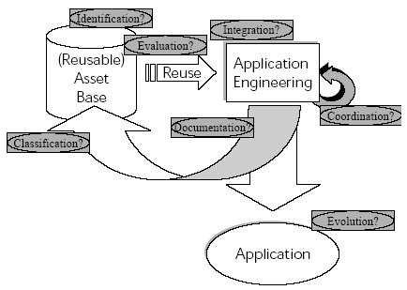
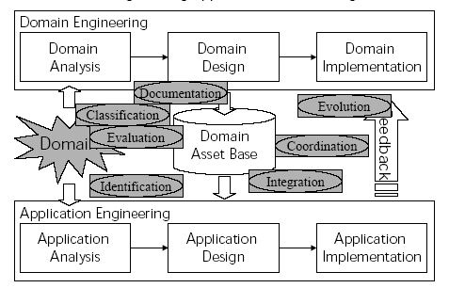
Domain engineering
The product portfolio of most software house can be structured in families/lines
All family members in same given domain, share common core conceptual entities and functionalities
Domain engineering: leverage distinction between common core and variable parts in a product family to foster reuse in the development process
Hardest issue: scoping domain
  Too large, excessive overhead, not cost-effective
  Too small, reuse potential poorly exploited

Slide 22
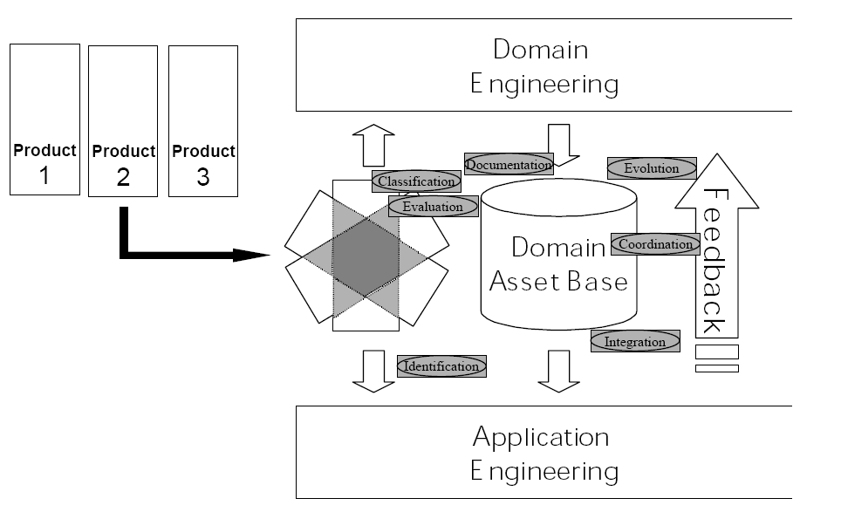
Product lines
Uses past, present and planned future products in a given domain
(product line) to delimit domain engineering
Domain restricted to common core of product line

Slide 23
Meta-programming and generative development
Raises asset abstraction:
  From artifact at given development stage S
  to meta-artifact defining mapping/transformation/generation
  from artifact template at stage S to artifact template at stage S+1
Mapping often specified declaratively and executed by generator tool

Slide 24


Assembly reuse vs. generative reuse
Assembly
reuse
new
artifact
a1
new
artifact
b1
manual specification
manual specification
reusable
artifact
a2
reusable
artifact
a3
new
artifact
b2
reusable
artifact
b3
manual assembly
manual assembly
Development Stage b
Development Stage a
Generative
reuse
manual
specification
source artifact template
reusable mapping
meta-artifact
target artifact template
manually specified
or generated from previous stage
input
matches
matches
generator tool
artifact
stage b
artifact
stage a
input
output

Slide 25
Current
Mainstream
OOSE
Abstraction
Domain Modeling w/ UML or DSML CASE Tool
Domain/ Business Model:
UML or DSML + Feature Tables + NL
Requirement Analysis
w/ UML or DSML CASE Tool
Specification Model:
(UML or DSML) + NL
High-Level Design
High-Level Design Model:
(UML or DSML) + NL
Detail Design (Refinement)
simultaneously with
Programming (Translation)
with Execution Platform IDE
Source
Code
Source Code
to Executable Code
Translation
Executable
Code
Executability

Slide 26
Manual MDE:
Extreme Modeling
Abstraction
Platform
Independent
Model (PIM)
Metamodeling
and/or Profiling
Platform
Specific
Model (PSM)
Metamodeling
and/or Profiling
PIM MetaModel
and/or UML Profile
Fully Refined
Requirement Analysis
w/ UML/OCL or
DSPIML CASE Tool
PSM MetaModel
and/or UML Profile
Fully Refined Specification
Platform Independent Model (PIM):
UML/OCL or DSPIML
High-Level
Design
w/ UML/OCL or
DSPIML CASE Tool
High-Level Realization PIM:
UML/OCL or DSPIML
Design
Full Refinement
w/ UML/OCL
or DSPIML CASE Tool
Fully Refined
Realization PIM:
UML/OCL
or DSPIML
PSM:
Profiled
UML/OCL
or DSPSML
Source
Code to
Executable
Code
Translation
PIM to PSM
Translation
PSM to
Source Code
Translation
Source
Code
Executable
Code
Executability

Slide 27
Transformation Based MDE:
UML Programming
Abstraction
Fully Refined
Requirement Analysis
w/ UML/OCL or
DSPIML CASE Tool
Fully Refined Specification
Platform Independent Model (PIM):
UML/OCL or DSPIML
High-Level
Realization PIM
Transformation
Base
High-Level
Realization PIM
Transformation
Development
PSM to
Source Code
Translation
Transformation
Development
High-Level
Design
w/ UML/OCL or
DSPIML CASE Tool
Realization PIM
Refinement
Transformation
Development
PIM to PSM
Translation
Transformation
Development
High-Level Realization PIM:
UML/OCL or DSPIML
PSM to
Source Code
Translation
Transformation
Base
Realization PIM
Refinement
Transformation
Base
PIM to PSM
Translation
Transformation
Base
Design
Full Refinement
w/ UML/OCL
or DSPIML CASE Tool
Fully Refined
Realization PIM:
UML/OCL
or DSPIML
PSM:
Profiled
UML/OCL
or DSPSML
Source
Code to
Executable
Code
Translation
PIM to PSM
Translation
PSM to
Source Code
Translation
Source
Code
Executable
Code
Executability

Slide 28
Separation of concern
Object-oriented design structures models and code solely based on the entity classes of the application and their relationships
This results into an non-isomorphic mapping between:
  The N concerns of the software being developed, i.e., its functional and non-functional requirements and the functionalities/behaviors realizing them in the model and code
  The M entity classes of the model and code
This makes adding or changing a single concern extremely costly for it requires:
  Inspecting the entire OO model/code
  Coherently modifying the many different classes in which it is scattered

Slide 29
Separation of concern
It also prevents exploiting the high concern reuse potential:
  Most concerns are conceptually orthogonal to one another and to the entity class structure of the application domain
  Yet they end-up entangled together in its model and code

Slide 30
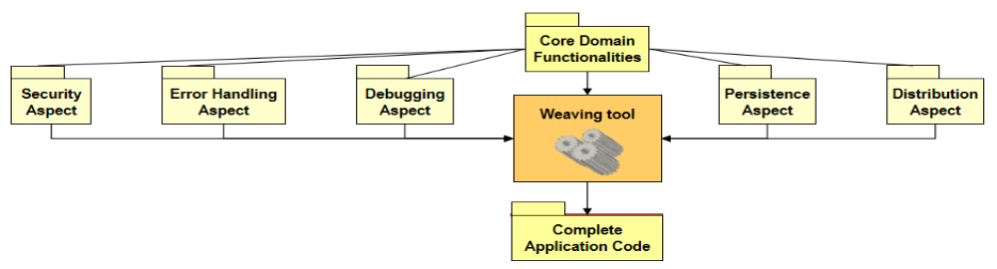
Aspect-Oriented Programming
Practice of
  Encapsulating orthogonal concerns in different aspects, to cleanly separate them from the core program and from one another
  Link each aspect with the core program (that captures the dominant decomposition) through point-cuts
  Automatically generate the complete source code by using AOP tools that weave together the aspects with the core program at the indicated point-cuts

Slide 31
Aspect-Oriented Development
Generalize aspect-oriented approach throughout the entire life-cycle at all level of abstraction and development stage
Aspects such as persistence, distribution, security, logging/tracing are largely orthogonal to the domain and functional requirement of any particular applications
Once modeled and implemented separately as aspects they can be reused
Even various ontological features of an application domain display a large extent of orthogonality than can be exploited using AOD:
  ex, recurrent e-commerce functionalities such as item browsing, item search, general promotions, personalized recommendations, payment, authentication, gifts, shopping cart management, delivery method and tracking, customer complaints

Slide 32
Integration of reuse techniques
Most reuse techniques are complementary and can be combined in synergy
MDA/AOD synergy:
  At the various MDA model levels (CIM, PIM, PSM)
  Modeling aspect weaving can be implemented by generic model transformation
  Separation between platform independent and platform dependent aspects further foster reuse
PLE/AOD synergy:
  Many PLE variations correspond to inclusion/exclusion of different aspects

Slide 33
Integration of reuse techniques
Recent reuse-oriented software engineering methods combined most of them:
  ex, KobrA
  Combines objects, patterns, frameworks, components, product lines, MDA.

Slide 34
Reuse-oriented software house organizations
Application
Application
Development
Team
Assemble
Reusable
Asset Base
Develop for reuse
Reusable Asset
Management
Team
Refactor for reuse
Submit potentially reusable assets
Application requirements
Design specification
Component
assembly
Reusable
Asset Base
Application
Project
Team
Experience
Factory
Integration
testing
Code
Components
Basili et al. 92
Five years experiment at Software Engineering Laboratory
(U. Maryland, NASA, Computer Science Corp.) with new structure
Reuse rates increased from 26% to 96%
Cost dropped 58%
Bug rates dropped 400%?

Slide 35
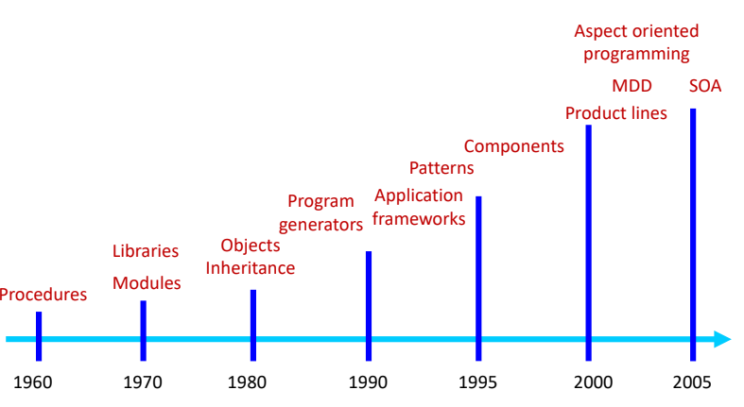
Technologies and Approaches

Slide 36
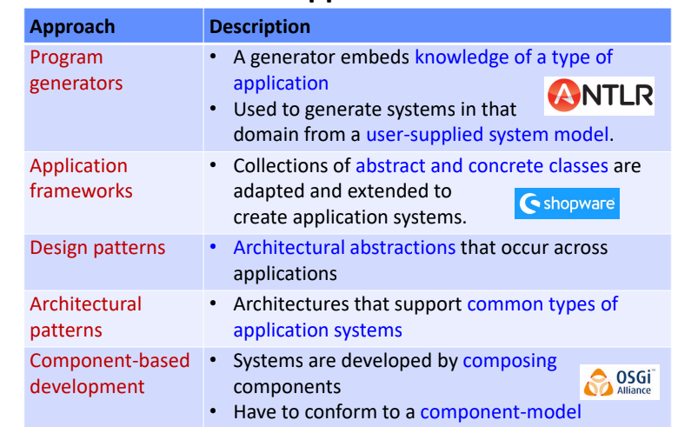
Reused Approaches-1

Slide 37
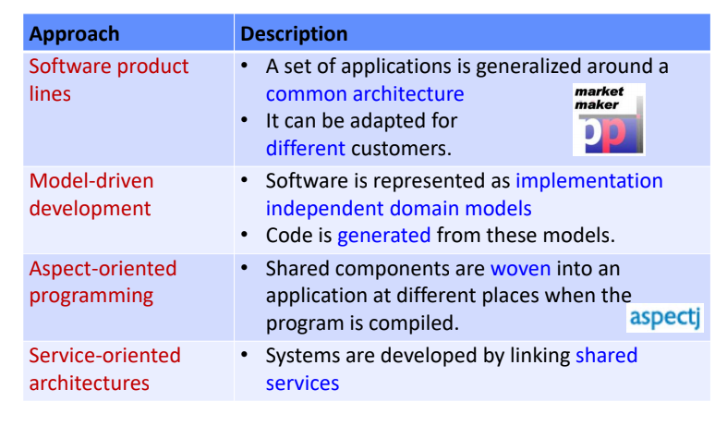
Reused Approaches-2

Slide 38
Cost benefit Model
Total costs consist of
  Additional effort needed to develop a reusable component.
  Costs to store and manage a reusable component in a repository.
  Costs to retrieve a component, to adapt and to integrate it.
Some investigations on reuse costs:
  50% Poulin and Caruso (1993)
  60% Tracz (1994)
  30 % additional generalization
  15 % additional documentation
  10 % additional testing
  5 % repository administration

Slide 39
Cost benefit Model
100% Margono and Rhoads (1992)
  15 % additional costs in analysis
  60 % in design
  25 % in testing

Slide 40
Cost benefit Model
100% Margono and Rhoads (1992)
  15 % additional costs in analysis
  60 % in design
  25 % in testing
Reuse is economical if adaptation costs are very low
Rule of thumb
  Adaptation costs <= 20 % of development costs
Important: Black-box reuse is not for free!
  ca. 5 % basic costs
The benefit of reusing a component is higher than the costs of its new development if it is reused at least 3 times!

Slide 41
Reuse economics
Reusability overhead:
  Estimated between 50% and 100%, 60% of which at the design stage (Margono & Rhoads 92, Poulin & Caruso 93)
Black-box building block reuse:
  Cost-effective, but limited potential until reuse program has matured (deadlocks reuse)
White-box building block reuse:
  Boehm 94 estimates that modifying 20% of code costs 90% of development from scratch
  Adaptation costlier across application domains and for third-party components (inhibits component markets)

Slide 42
Reuse economics
Building block granularity trade-off:
  The larger the component, the more is saved each time it is reused
  The smaller the component, the more often it can be reused
  Suggests recursive sub-component structure
Meta-level reuse:
  Development cost of asset generators rises sharply as their requirements approach full automation

Slide 43
Recommended Reuse Metrics -Poulin
Reuse%
Reuse Cost Avoidance (RCA)
Organizational ROI (Rol org)

Slide 44
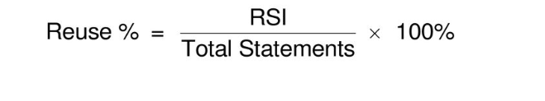

Recommended Reuse Metrics -Poulin
Reuse% example:
Your programming team developed and maintains 100k LOC, and also uses 20k LOC from an external source. Your team’s Reuse% equals:

Slide 45
Recommended Reuse Metrics -Poulin
Reuse Cost Avoidance (RCA)
Purpose: A Cost Avoidance metric used to show the financial benefit of reusing software to the individual project or team
RCA represents money you didn’t have to spend.
Identify cost avoidance
  During development
  During service (i.e., maintenance)

Slide 46

Recommended Reuse Metrics -Poulin
Reuse Cost Avoidance (RCA)
Development: The benefits of reuse depend on the Relative Cost of Reuse (RCR). With an RCR=0.2, reuse costs about 20% of the cost of new development. Therefore Development Cost Avoidance (DCA):
  DCA = RSI x (1 - RCR) x (New Code Cost)
  DCA = RSI x .8 x (New Code Cost)
Service: Not having to fix errors results in a Service Cost Avoidance (SCA):
  SCA = RSI x (Your Error Rate) x (Your Error Cost)

Slide 47
Recommended Reuse Metrics -Poulin
RCA Example Development:
  If your development cost for new code equals $100 per line and your RCR = 0.2, then your DCA for 20k LOC RSI equals:
    Development Cost Avoidance = 20k LOC x .8 x $100 per line= $1.6 million
  Service: If your error rate for new code equals 1.5 errors per kLOC and if your cost to fix an error equals $10k, then your SCA for 20k LOC RSI equals:
    Service Cost Avoidance = 20k LOC x 1.5 errors per kLOC x $10k per error= $0.3 million
  Total Reuse Cost Avoidance:
    Reuse Cost Avoidance = DCA + SCA= $1.6 million + $0.3 million= $1.9 million

Slide 48
Recommended Reuse Metrics -Poulin
Organizational ROI Purpose:
To show the total financial benefit to an organization from:
  1. Reusing software
  2. Building software to reuse
ROIorg = RCA - Additional Development CostsAdditional
Development Costs (ADC) = (the amount of source instructions you write for reuse by others) *(Relative Cost of Writing for Reuse - 1) * New Code Cost

Slide 49
Recommended Reuse Metrics -Poulin
Organizational ROI Example
You have calculated your Reuse Cost Avoidance (RCA) (the net benefit of reuse) to equal $1.9 million. However, you also invested extra effort in 16,000 LOC Source Instructions Written for Reuse by Others (WRO). With an RCWR = 1.5, your Additional Development Cost (ADC) equals:
  ADC = WRO x (RCWR - 1) x New Code Cost
  ADC = 16k LOC x ( ) x $100 per line= $.8 million
Organizational ROI
  ROIorg = RCA - ADC= $1.9 million - $0.8 million= $1.1 million

Slide 50
Recommended Reuse Metrics -Poulin
Easy to write, easy to reuse
Hard to write, hard to reuse
The more difficult to write, the longer it takes to pay back.
The more difficult to reuse, the longer it takes to pay back.
With RCWR = 1.5 and RCR = 0.20 show break- even at less than 1 use + 1 reuse.

Slide 51
Summary
Motivation for Reuse
  Development of reusable components must be rewarded!
  Nobody develops a reusable component if he/she does not profit by it.
  Reusable components must be known and maintained!
  The quality must be higher than “normal”
  Projects must reuse existing components!
  Not-invented-here syndrome!
  The benefit of reuse must be measured! (by means of metrics)
  Costs must be known!

Slide 52
Summary
Reuse must always be considered under economical constraints.
  Sometimes hard to demonstrate!
Modern technologies support development of reusable components!
However reuse comes not for free!
The applied development process must support reuse as well!
  Reuse strategy!
  Benefit should be measured to be known!

